Slide 1
Chapter 2: Basics of Algorithm Analysis
Fall 2013
Prof. Peng-Jun Wan

Slide 2
2.1 Computational Tractability
"For me, great algorithms are the poetry of computation. Just like verse, they can be terse, allusive, dense, and even mysterious. But once unlocked, they cast a brilliant new light on some aspect of computing." - Francis Sullivan

Slide 3
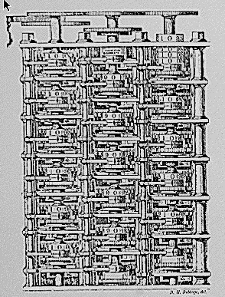
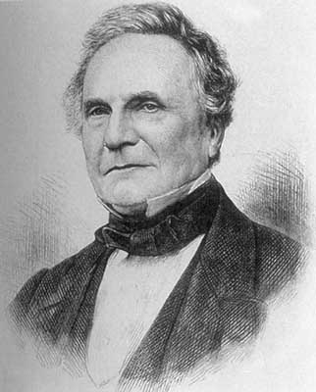
Computational Tractability
As soon as an Analytic Engine exists, it will necessarily guide the future course of the science. Whenever any result is sought by its aid, the question will arise - By what course of calculation can these results be arrived at by the machine in the shortest time? - Charles Babbage
Charles Babbage (1864)
Analytic Engine (schematic)

Slide 4
Polynomial-Time
Brute force. For many non-trivial problems, there is a natural brute force search algorithm that checks every possible solution.
  Typically takes 2^{N} time or worse for inputs of size N.
  Unacceptable in practice.
Desirable scaling property. When the input size doubles, the algorithm should only slow down by some constant factor C.
Def. An algorithm is poly-time if the above scaling property holds.
n ! for stable matching
with n men and n women
There exists constants c > 0 and d > 0 such that on every input of size N, its running time is bounded by c N^{d} steps.
choose C = 2^{d}
Notes:
focusing on worst-case poly-time is a subtle modeling decision - we try to justify it here

Slide 5
Worst-Case Analysis
Worst case running time. Obtain bound on largest possible running time of algorithm on input of a given size N.
  Generally captures efficiency in practice.
  Draconian view, but hard to find effective alternative.
Average case running time. Obtain bound on running time of algorithm on random input as a function of input size N.
  Hard (or impossible) to accurately model real instances by random distributions.
  Algorithm tuned for a certain distribution may perform poorly on other inputs.

Slide 6
Worst-Case Polynomial-Time
Def. An algorithm is efficient if its running time is polynomial.
Justification: It really works in practice!
  Although 6.02 × 10²³ × N²⁰ is technically poly-time, it would be useless in practice.
  In practice, the poly-time algorithms that people develop almost always have low constants and low exponents.
  Breaking through the exponential barrier of brute force typically exposes some crucial structure of the problem.
Exceptions.
  Some poly-time algorithms do have high constants and/or exponents, and are useless in practice.
  Some exponential-time (or worse) algorithms are widely used because the worst-case instances seem to be rare.
simplex method
Unix grep

Slide 7
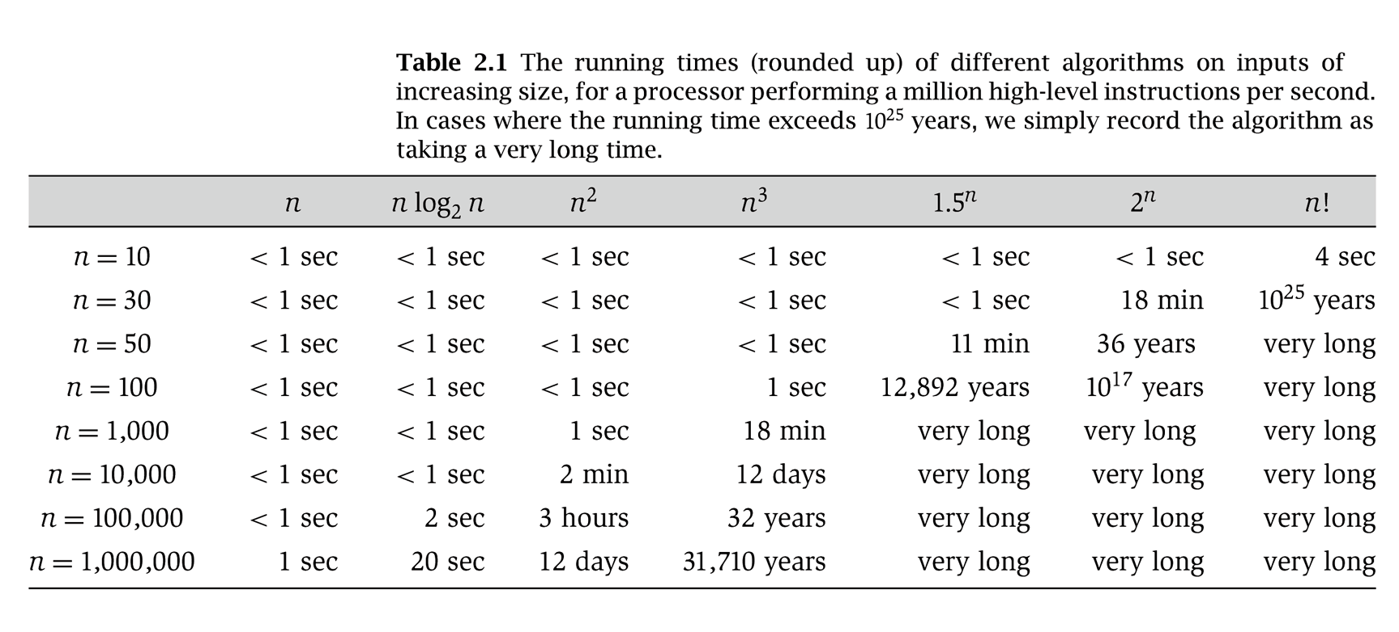
Why It Matters
Notes:
table taken from More Programming Pearls, p. 82, 400MhZ Pentium II scaled up
one step takes one nanosecond
msec = millisecond

Slide 8
2.2 Asymptotic Order of Growth

Slide 9
Asymptotic Order of Growth
Upper bounds. T(n) is O(f(n)) if there exist constants c > 0 and n₀ ≥ 0 such that for all n ≥ n₀ we have T(n) ≤ c · f(n).
Lower bounds. T(n) is Ω(f(n)) if there exist constants c > 0 and n₀ ≥ 0 such that for all n ≥ n₀ we have T(n) ≥ c · f(n).
Tight bounds. T(n) is Θ(f(n)) if T(n) is both O(f(n)) and Ω(f(n)).
Ex: T(n) = 32n² + 17n + 32.
  T(n) is O(n²), O(n³), Ω(n²), Ω(n), and Θ(n²) .
  T(n) is not O(n), Ω(n³), Θ(n), or Θ(n³).

Slide 10
Notation
Slight abuse of notation. T(n) = O(f(n)).
  Asymmetric:
    f(n) = 5n³; g(n) = 3n²
    f(n) = O(n³) = g(n)
    but f(n) ≠ g(n).
  Better notation: T(n) ∈ O(f(n)).
Meaningless statement. Any comparison-based sorting algorithm requires at least O(n log n) comparisons.
  Statement doesn't "type-check."
  Use Ω for lower bounds.

Slide 11
Properties
Transitivity.
  If f = O(g) and g = O(h) then f = O(h).
  If f = Ω(g) and g = Ω(h) then f = Ω(h).
  If f = Θ(g) and g = Θ(h) then f = Θ(h).
Additivity.
  If f = O(h) and g = O(h) then f + g = O(h).
  If f = Ω(h) and g = Ω(h) then f + g = Ω(h).
  If f = Θ(h) and g = O(h) then f + g = Θ(h).

Slide 12
Asymptotic Bounds for Some Common Functions
Polynomials. a₀ + a₁n + … + a_{d}n^{d} is Θ(n^{d}) if a_{d} > 0.
Polynomial time. Running time is O(n^{d}) for some constant d independent of the input size n.
Logarithms. O(log _{a} n) = O(log _{b} n) for any constants a, b > 0.
Logarithms. For every x > 0, log n = O(n^{x}).
Exponentials. For every r > 1 and every d > 0, n^{d} = O(r^{n}).
can avoid specifying the base
log grows slower than every polynomial
every exponential grows faster than every polynomial

Slide 13












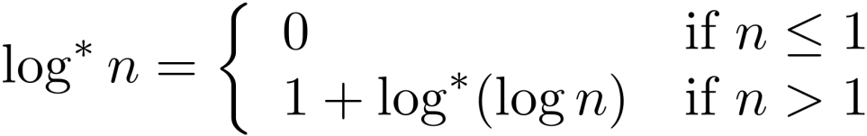
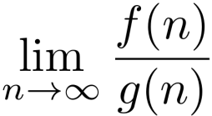
In-class exercise: Sort in ascending order
One proof strategy: use
Notes:
L’hospital rule comes handy: if lim(f(n) and lim(g(n)) are both infinity and derivatives exist, then lim(f(n) / g(n)) = lim (f’(n) /g’(n))
Stirling’s formula: ln(n!) =nlnn-n+O(lnn)

Slide 14
2.4 A Survey of Common Running Times

Slide 15
Linear Time: O(n)
Linear time. Running time is at most a constant factor times the size of the input.
Computing the maximum. Compute maximum of n numbers a₁, …, a_{n}.
max ← a₁
for i = 2 to n {
if (a_{i} > max)
max ← a_{i}
}

Slide 16
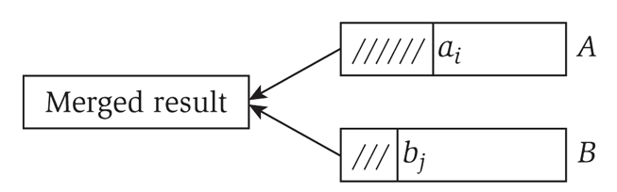
Linear Time: O(n)
Merge. Combine two sorted lists A = a₁,a₂,…,a_{n} with B = b₁,b₂,…,b_{n} into sorted whole.
Claim. Merging two lists of size n takes O(n) time.
Pf. After each comparison, the length of output list increases by 1.
i = 1, j = 1
while (both lists are nonempty) {
if (a_{i} ≤ b_{j}) append a_{i} to output list and increment i
else(a_{i} ≤ b_{j})append b_{j} to output list and increment j
}
append remainder of nonempty list to output list

Slide 17
O(n log n) Time
O(n log n) time. Arises in divide-and-conquer algorithms.
Sorting. Mergesort and heapsort are sorting algorithms that perform O(n log n) comparisons.
Largest empty interval. Given n time-stamps x₁, …, x_{n} on which copies of a file arrive at a server, what is largest interval of time when no copies of the file arrive?
O(n log n) solution. Sort the time-stamps. Scan the sorted list in order, identifying the maximum gap between successive time-stamps.
also referred to as linearithmic time

Slide 18
Quadratic Time: O(n²)
Quadratic time. Enumerate all pairs of elements.
Closest pair of points. Given a list of n points in the plane (x₁, y₁), …, (x_{n}, y_{n}), find the pair that is closest.
O(n²) solution. Try all pairs of points.
Remark. Ω(n²) seems inevitable, but this is just an illusion.
min ← (x₁ - x₂)² + (y₁ - y₂)²
for i = 1 to n {
for j = i+1 to n {
d ← (x_{i} - x_{j})² + (y_{i} - y_{j})²
if (d < min)
min ← d
}
}
don't need to
take square roots
see chapter 5

Slide 19
Cubic Time: O(n³)
Cubic time. Enumerate all triples of elements.
Set disjointness. Given n sets S₁, …, S_{n} each of which is a subset of
1, 2, …, n, is there some pair of these which are disjoint?
O(n³) solution. For each pairs of sets, determine if they are disjoint.
foreach set S_{i} {
foreach other set S_{j} {
foreach element p of S_{i} {
determine whether p also belongs to S_{j}
}
if (no element of S_{i} belongs to S_{j})
report that S_{i} and S_{j} are disjoint
}
}

Slide 20
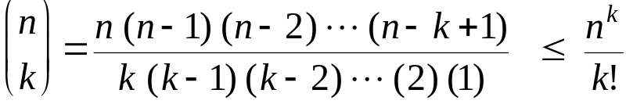
Polynomial Time: O(n^{k}) Time
Independent set of size k. Given a graph, are there k nodes such that no two are joined by an edge?
O(n^{k}) solution. Enumerate all subsets of k nodes.
  Check whether S is an independent set = O(k²).
  Number of k element subsets =
  O(k² n^{k} / k!) = O(n^{k}).
k is a constant
foreach subset S of k nodes {
check whether S in an independent set
if (S is an independent set)
report S is an independent set
}
}
poly-time for k=17,
but not practical

Slide 21
Exponential Time
Independent set. Given a graph, what is maximum size of an independent set?
O(n² 2^{n}) solution. Enumerate all subsets.
S* ← φ
foreach subset S of nodes {
check whether S in an independent set
if (S is largest independent set seen so far)
update S* ← S
}
}

